Slide 1
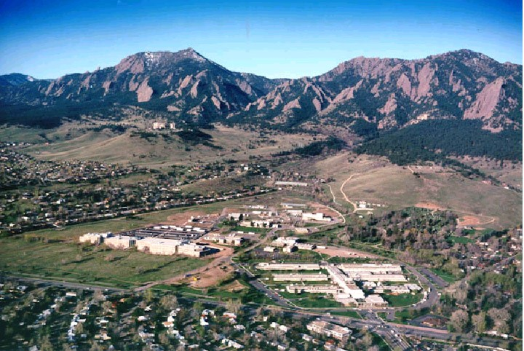

GPS calibrations
for UTC contributors
Stefania Römisch, Bijunath Patla

Slide 2
OUTLINE
Time transfer using GPS common-view
GNSS differential calibrations
  Definition of a local time reference point
  Local delays measurements
  Uncertainty budget
The NIST travelling system
  Description
  Setup Demo
Requirements for calibration campaigns
  Laboratory information
  Data formats
  Logistics

Slide 3
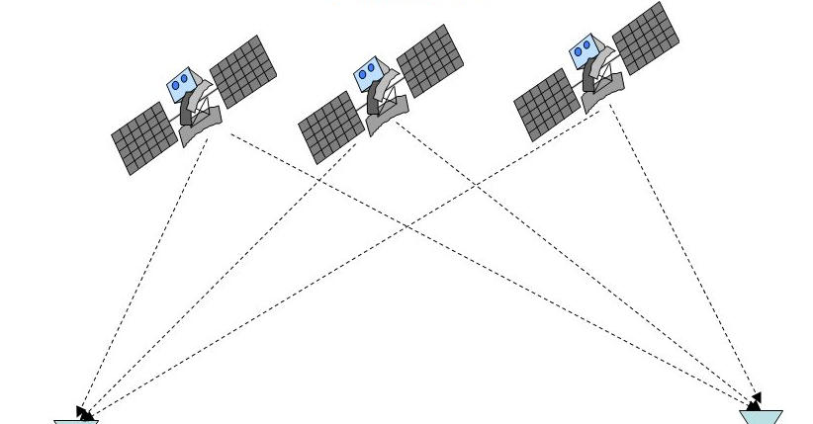

GPS common-view
GPS receiver
TIME TRANSFER
GPS receiver
Clock A
Clock B
Δt_{A} = CLOCK A - GPStime
Δt_{B} = CLOCK B - GPStime
5/10 MHz
Clock A – Clock B = Δt_{A} - Δt_{B}
1 PPS

Slide 4
Local Delays
5/10 MHz
1 PPS
CABDLY
GPS receiver
INTDLY
REFDLY
calibrations
Δt = (Clock A +REFDLY) - (GPStime +CABDLY) + INTDLY
Local measurements
Clock A –Clock B = Δt_{A} - Δt_{B}
+ (REFDLY_{A} – REFDLY_{B}) - (CABDLY_{A} - CABDLY_{B}) + INTDLY_{A} - INTDLY_{B}

Slide 5
BIPM Calibration Campaigns
Based on differential calibration trips with closure.
The trip begins and ends at the same laboratory (i.e. NIST), where the reference receiver for that trip is located.
The traveling receiver is just a transfer system between the reference receiver and the visited receivers of that trip.
Calibration Identifiers are generated for every calibration trip
znnn-YYYY
1: diff. cal. with closure
2: other (i.e. manuf. cal., absolute cal. etc.)
year
000-009: G1
011-099: G2
101-999: other

Slide 6
Differential Calibration
COMMON-CLOCK MEASUREMENT
REFERENCE LAB
Δt= (GPStime +CABDLY_{T}) − (Clock R +REFDLY_{T,R}) + INTDLY_{T}
CABDLY_{T}
TRAV receiver
INTDLY_{T}
CABDLY_{R}
ΔINTDLY_{R-T} =
(Δt)_{R} - (Δt)_{T,R} - (CABDLY_{R} - CABDLY_{T}) + (REFDLY_{R} – REFDLY_{T,R})
REFDLY_{T,R}
LOCAL receiver
INTDLY_{R}
REFDLY_{R}
Clock R
Δt= (GPStime +CABDLY_{R}) − (Clock R +REFDLY_{R}) + INTDLY_{R}
5/10 MHz
1 PPS

Slide 7
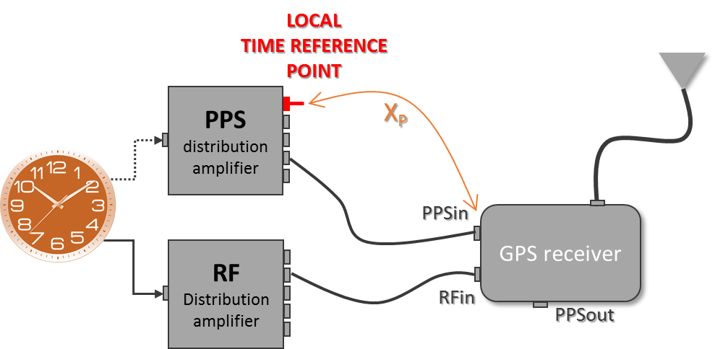
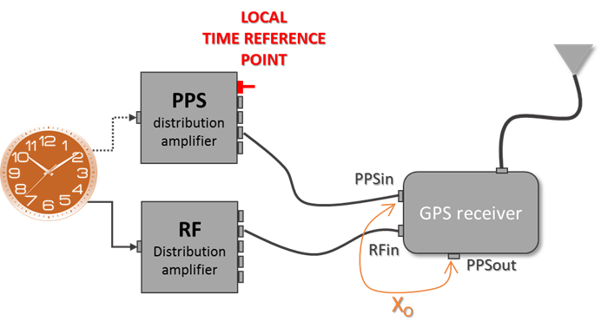
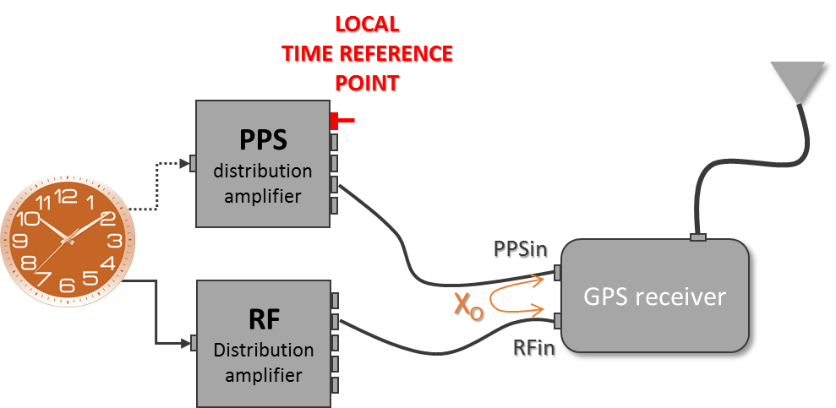
Local Delays: REFDLY
“REFDLY=(delay between UTC(k) and PPSin) + (delay between PPSin and RCVR’s internal ref. point)”
X_{P}
X_{O}
OR
REFDLY = X_{P} + X_{O}
When PPSout is NOT available
OR X_{O} = 0

Slide 8
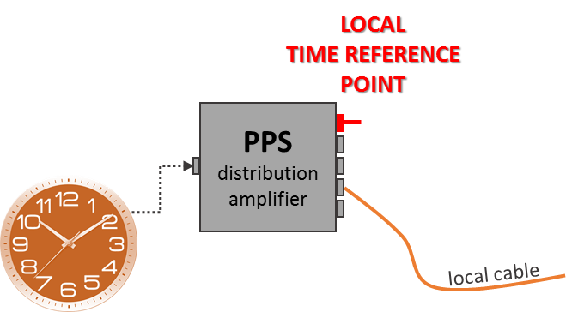
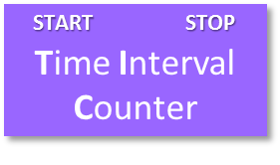
Local Delays: REFDLY
Delay with respect to a reference point using a PIVOT
CBL2
1st measurement:
UTC(k) - PIVOT
CBL1
X_{P} = PPSin – UTC(k)
CBL1
2nd measurement:
PPSin - PIVOT
CBL2
SETUP
TIC: 50 Ohms, positive edge, 1V trigger point
CBL2 longer than CBL1
Multiple TIC measurements if possible

Slide 9
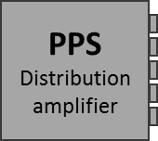
Local Delays: CABDLY
Delay of antenna cable
BEST: using a network analyzer at L1 and L2 center frequencies
GOOD: using a TIC and PPS signals.
CBL2
CBL1
CBL2
CBL1
CABDLY= 2nd meas – 1st meas
SETUP
TIC: 50 Ohms, positive edge, 1V trigger point
CBL2 longer than CBL1
Multiple TIC measurements if possible

Slide 10
Differential Calibration
COMMON-CLOCK MEASUREMENT
REFERENCE LAB
Δt= (GPStime +CABDLY_{T}) − (Clock R +REFDLY_{T,R}) + INTDLY_{T}
CABDLY_{T}
TRAV receiver
INTDLY_{T}
CABDLY_{R}
ΔINTDLY_{R-T} =
(Δt)_{R} - (Δt)_{T,R} - (CABDLY_{R} - CABDLY_{T}) + (REFDLY_{R} – REFDLY_{T,R})
REFDLY_{T,R}
LOCAL receiver
INTDLY_{R}
REFDLY_{R}
Clock R
Δt= (GPStime +CABDLY_{R}) − (Clock R +REFDLY_{R}) + INTDLY_{R}
5/10 MHz
1 PPS

Slide 11
Differential Calibration
COMMON-CLOCK MEASUREMENT
VISITED LAB
Δt= (GPStime +CABDLY_{T}) − (Clock V +REFDLY_{T,V}) + INTDLY_{T}
CABDLY_{T}
TRAV receiver
INTDLY_{T}
ΔINTDLY_{V-T} =
(Δt)_{V} - (Δt)_{T,V} - (CABDLY_{V} - CABDLY_{T}) + (REFDLY_{V} - REFDLY_{T})
CABDLY_{v}
REFDLY_{T,V}
LOCAL receiver
INTDLY_{v}
REFDLY_{v}
Clock V
Δt= (GPStime +CABDLY_{V}) − (Clock V +REFDLY_{V}) + INTDLY_{V}
5/10 MHz
1 PPS

Slide 12
Differential Calibration
REFERENCE LAB
VISITED LAB
CABDLY_{R}
CABDLY_{V}
GPS receiver
INTDLY_{R}
GPS receiver
INTDLY_{V}
REFDLY_{R}
REFDLY_{V}
Clock R
Clock V
ΔINTDLY_{V-T} - ΔINTDLY_{R-T} = ΔINTDLY_{V-R}
5/10 MHz
1 PPS

Slide 13
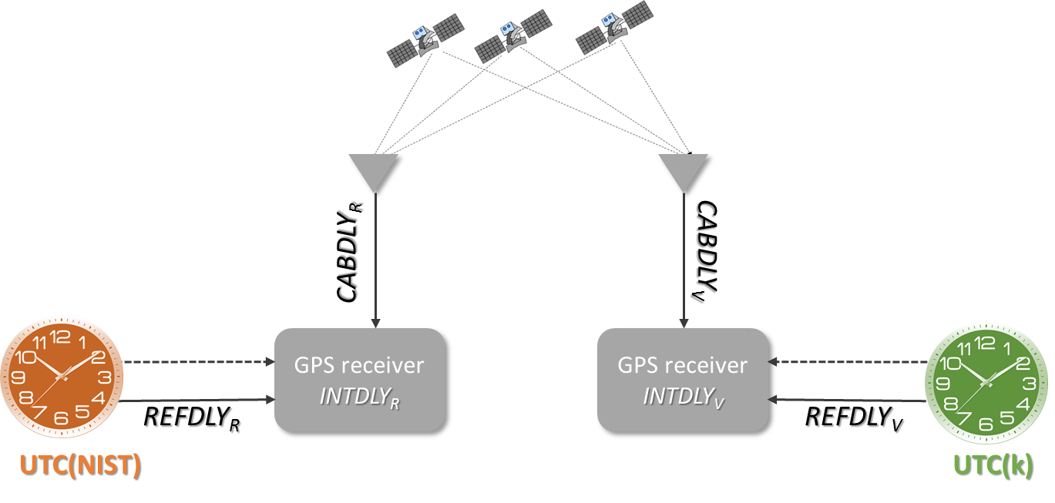
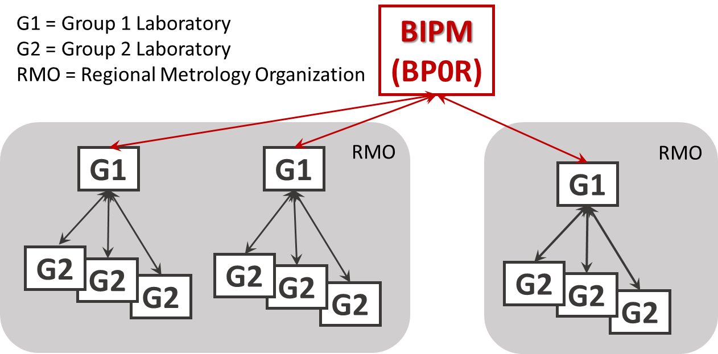
Differential Calibration
ΔINTDLY_{k-T} - ΔINTDLY_{NIST-T} = ΔINTDLY_{Labk-NIST}
G1 campaigns: ΔINTDLY_{NIST-BIPM}
ΔINTDLY_{Labk-BIPM}
from “BIPM guidelines for GNSS calibration” V3.2

Slide 14


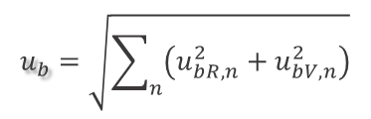
Calibration Uncertainty
ΔINTDLY_{V-R} = (Δt)_{R} - (Δt)_{T,R} - CABDLY_{R} + CABDLY_{T} + REFDLY_{R} – REFDLY_{T,R}
-[(Δt)_{V} - (Δt)_{T,V} - CABDLY_{V} + CABDLY_{T} + REFDLY_{V} – REFDLY_{T,V}]
Uncertainty
of the differential calibration
$$u_{CAL}=\sqrt{u_{a}^{2}+u_{b}^{2}}$$
$$u_{a}=\sqrt{u_{aR}^{2}+u_{aV}^{2}}$$
Mis-closure:
ΔINTDLY_{R-T, end} - ΔINTDLY_{R-T, beginning}
Statistical analysis of RAWDIF (0.2ns)
Mis-closure > 2u_{CAL}
$$u_{b}=\sqrt{\sum_{n}{\left(u_{bR,n}^{2}+u_{bV,n}^{2}\right)}}$$
Position error (0.05 ns) and multipath (0.3ns) (RAWDIF)
Local delay measurements (REFDLY) (0.5ns)
Antenna delay measurements (CABDLY) (0.5 ns)
Invalid calibration
OR
u_{CAL} = mis-closure

Slide 15
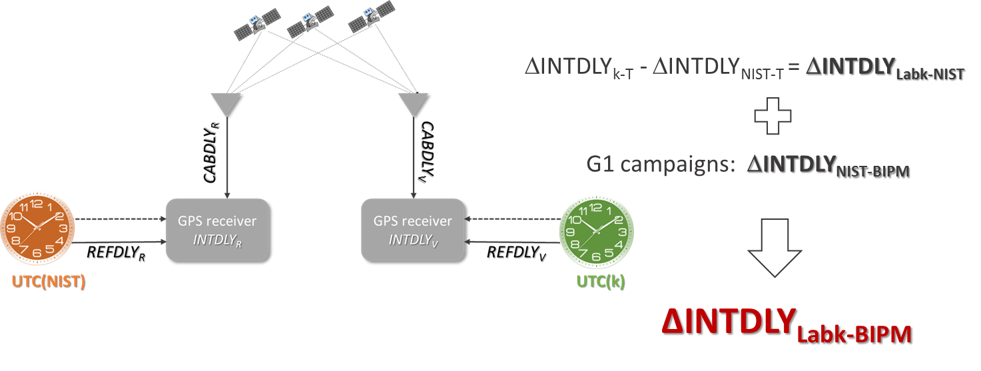

Calibration Uncertainty
UTC links
Calibration Identifier
10nn-YYY
u_{CAL0}
uncertainty associated to Calibration Identifier (trip)
TAI computation uses links with PTB as pivot
UTC(k)-UTC(PTB)
u_{CAL0}│_{G2-PTB} = 2.5 ns
Labk-NIST
NIST-BIPM
PTB-BIPM

Slide 16
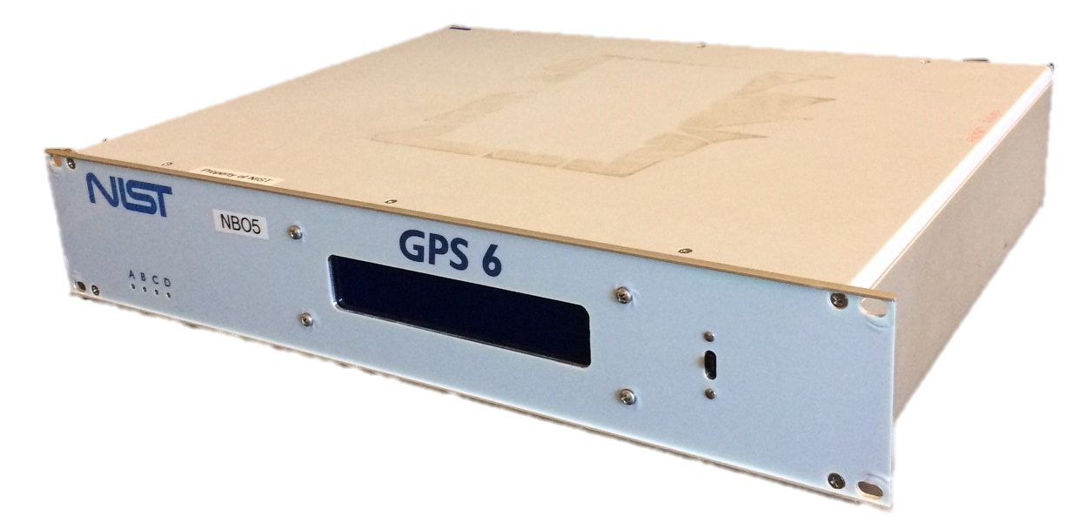
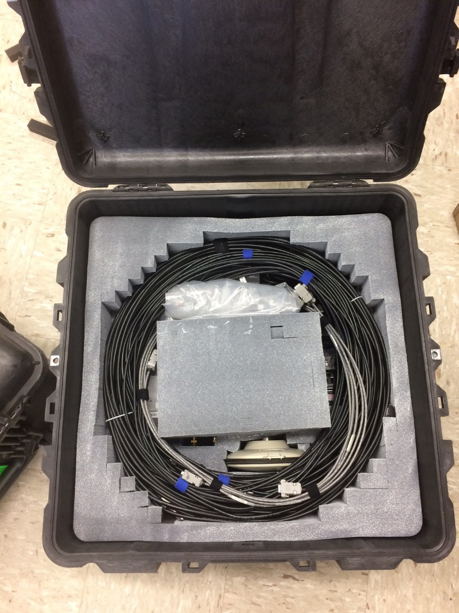
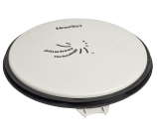
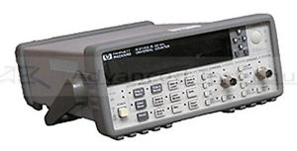

NIST Travelling System
GPS receiver NB05
Pinwheel GPS Antenna
Antenna cable
TIC for local delay measurements
Laptop
Coax and serial cables, etc.

Slide 17
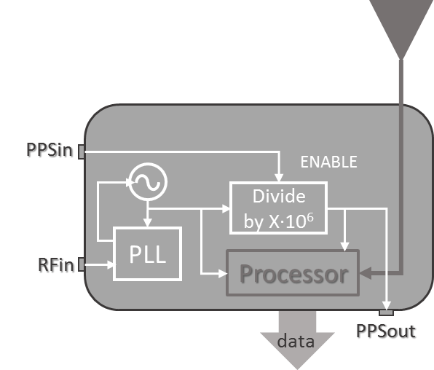
NIST Travelling System
Inside NB05
The quartz oscillator inside the receiver is locked to the RFin, to improve its stability
PPSin enables the internal PPS generator, allowing the synchronization of the receiver’s time base to the local time reference
PPSout is the best representation of the receiver’s time base
PPSout – PPSin is continually monitored: it provides information about the receiver’s time base
GPS receiver

Slide 18
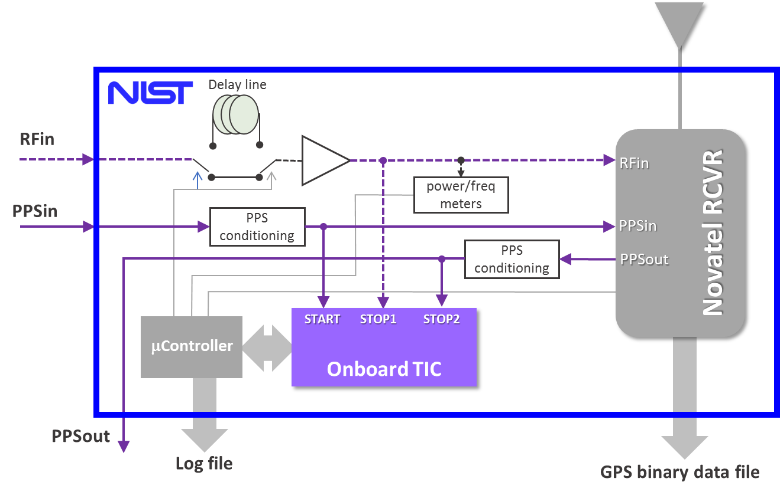
NIST Travelling System
5/10 MHz
Inside NB05
1 PPS
Every 100 s the onboard TIC measures
  PPSout - PPSin (X_{O})
  RFin - PPSin
RS232
Only positive delays!

Slide 19
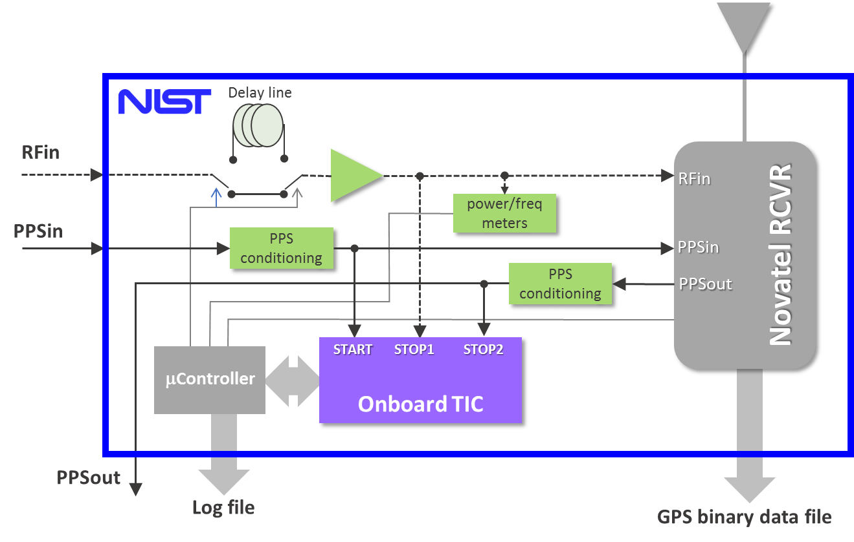
NIST Travelling System
5/10 MHz
Inside NB05
1 PPS
RFin is amplified, power and frequency coarsely measured
PPSin and PPSout are re-triggered at 0.5V
RS232
PPSin, PPSout: TTL, 50 Ohms
RFin: 5 or 10 MHz, -3 to +5 dBm, 50 Ohm

Slide 20
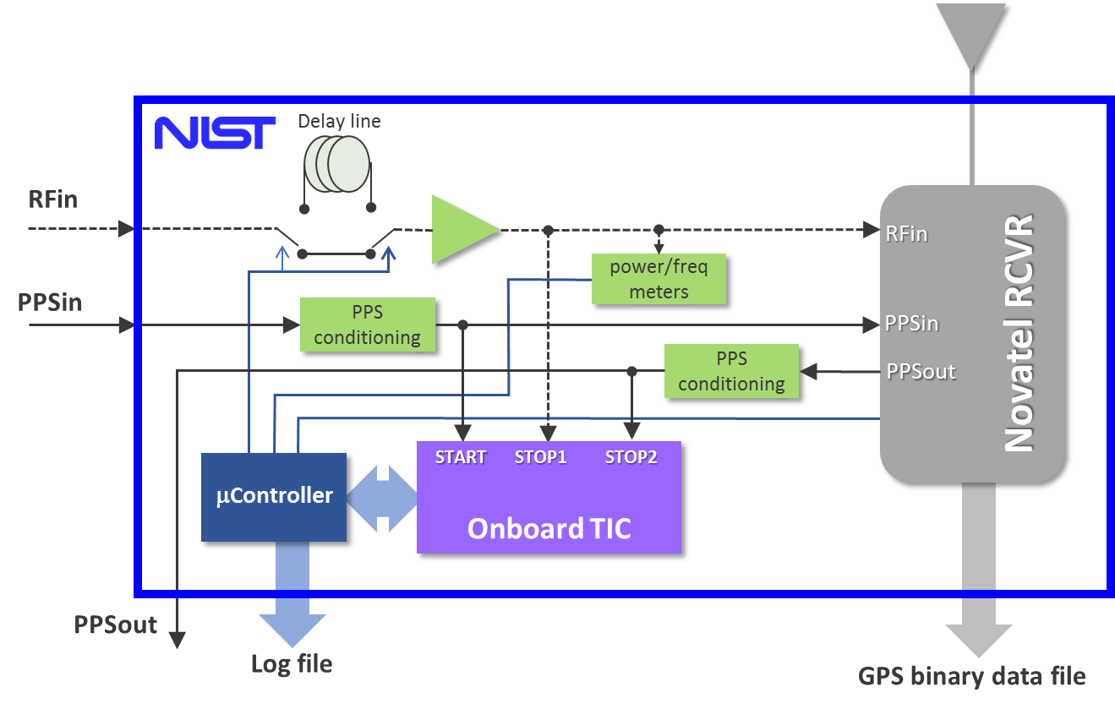
NIST Travelling System
5/10 MHz
Inside NB05
1 PPS
μcontroller provides:
  Receiver’s health
  RF power and frequency
  TIC measurements
  Delay line control
RS232
Log file: file logged by LV app

Slide 21
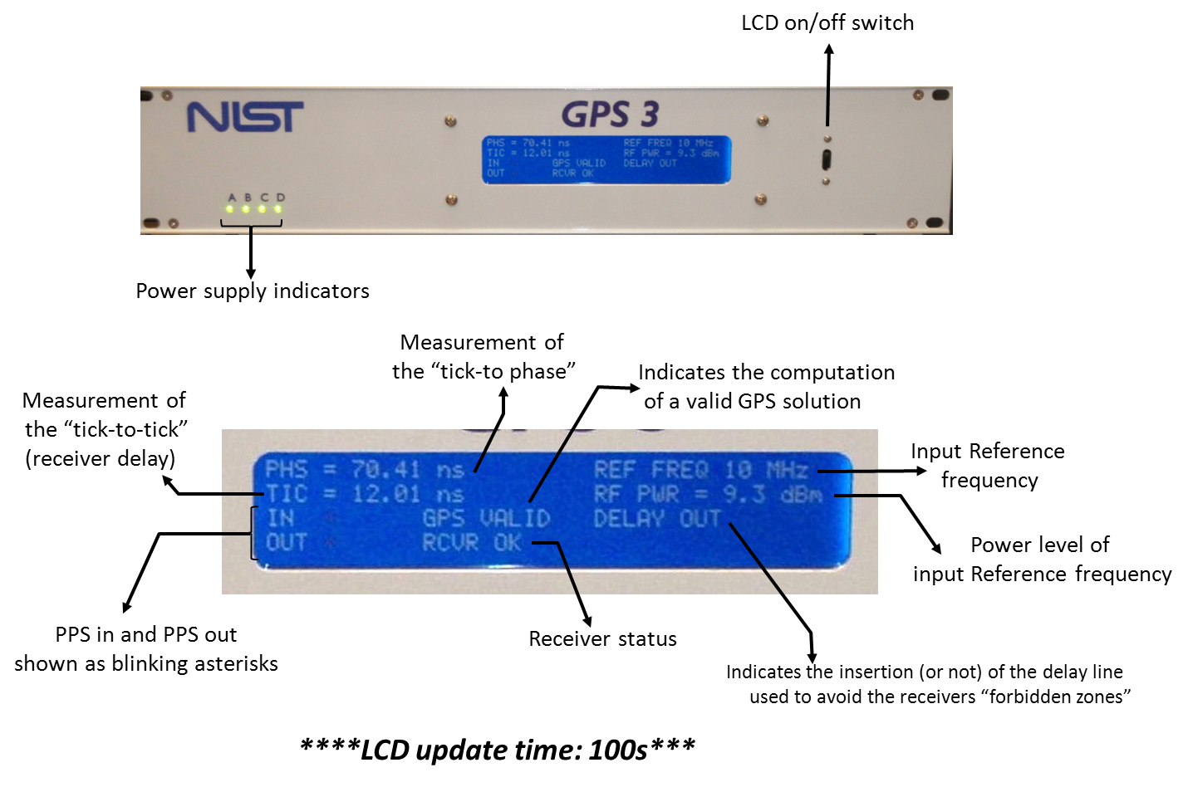
NIST Travelling System

Slide 22
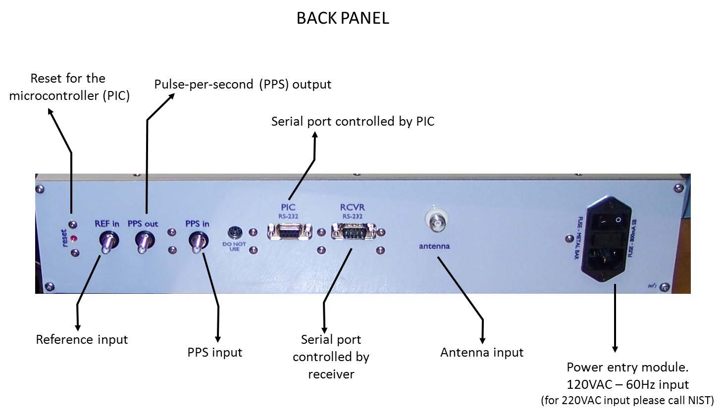
NIST Travelling System

Slide 23
Receiver setup

Slide 24
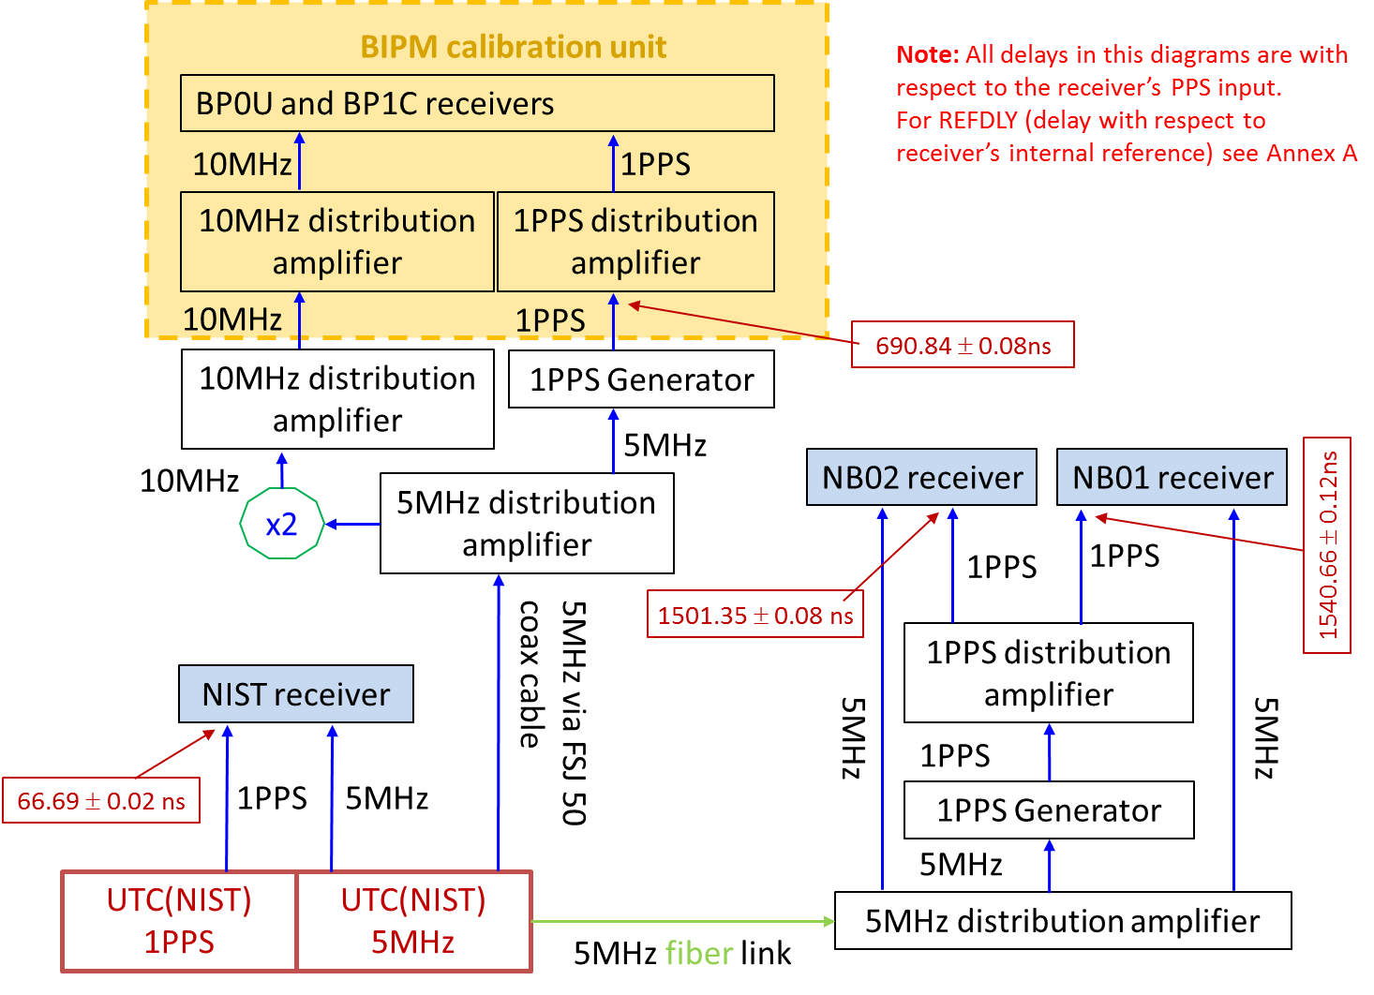
Calibration Trips Requirements
LABORATORY INFORMATION
Block diagram illustrating local setup, including the NIST travelling receiver
Information sheet (one for each local receiver)

Slide 25
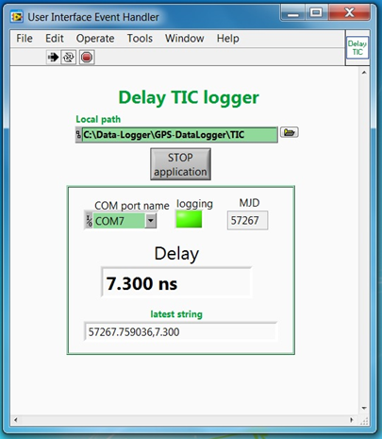
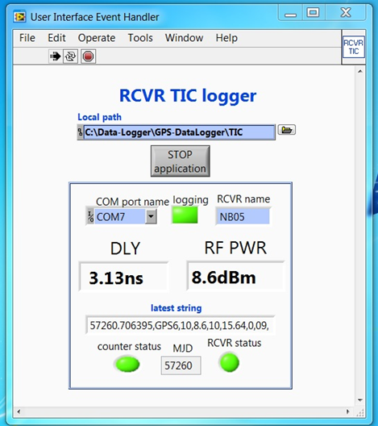
Calibration Trips Requirements
DATA AND FILE FORMATS
Local delays for NIST travelling receiver:
CABDLY (provided)
REFDLY = X_{P} +X_{O}
Local delays for LAB_{k} receiver:
CABDLY (from past measurements)
REFDLY = X_{P} +X_{O}
Measurements using provided cables, TIC and data logger
(beginning and end of visit)
Continuous logging after initial setup is completed
BEST: measured at beginning and end of visit
GOOD: data from latest measurement
Delay-MMJDD.dat
TIC-NB05-MMJDD.dat

Slide 26
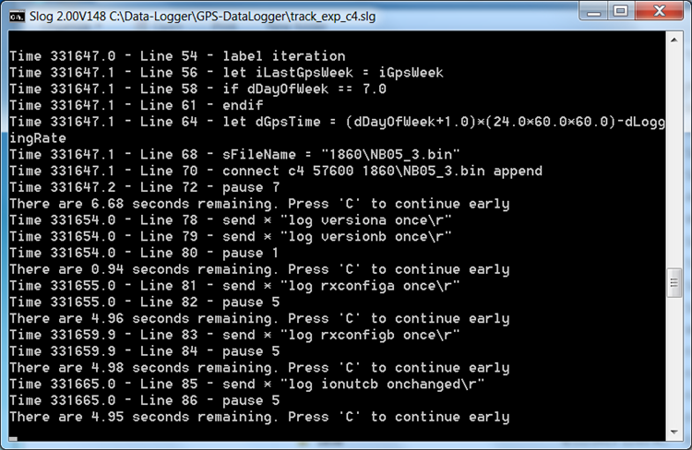
Calibration Trips Requirements
DATA AND FILE FORMATS
5 continuous days of GPS data are required as a minimum at each location
GPS data files for NIST travelling receiver
GPS data files for LAB_{k} receiver
RINEX
Do not enforce clock corrections
CGGTTS
Ver. 2 or higher
NB05_dow.bin
NB05doy0.YYO
NB05doy0.YYN
Rinex

Slide 27


Calibration Trips Requirements
LOGISTICS
All data files need to be uploaded on a secure location provided by NIST
The duration of each calibration trip should be kept at a minimum
The NIST travelling system has a packing list and photographs of the packed enclosure to facilitate re-packing
INTERNATIONAL SHIPPING VIA ATA CARNET
Provides documentation for temporary import/export
Does not require additional custom brokerage by the country that recognize it
Requires reachable contact personnel at all locations indicated
The carnet must be with the package at all times (the shipping company must deliver it together with the package)

Slide 28
THANK YOU!
for this opportunity
and
for participating in the SIM G2 campaigns
BIPM Calibration Guidelines
ftp://ftp2.bipm.org/pub/tai/publication/gnss-calibration/guidelines/

Slide 29
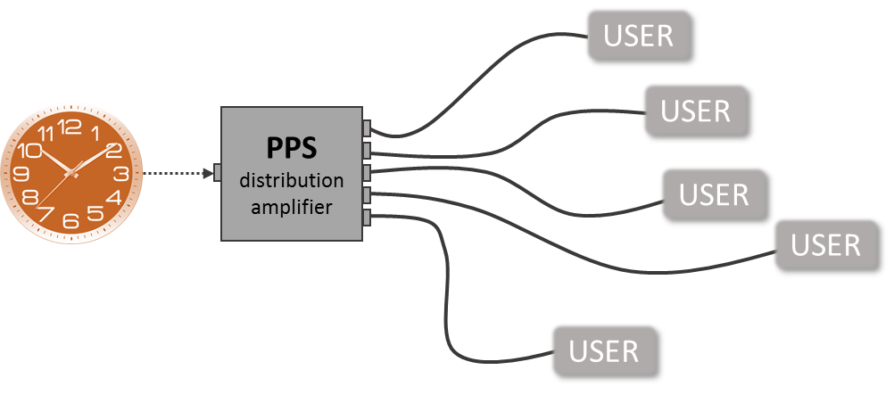


UTC(k) Best Practices
Definition of Local Time Reference Point
LOCAL
TIME REFERENCE POINT
USER
PPS distribution amplifier
USER
USER
The Local Time Reference Point must be accessible at all times!
USER

Slide 30

Local Delays: REFDLY
“REFDLY=(delay between UTC(k) and PPSin) + (delay between PPSin and RCVR’s internal ref. point)”
X_{O}
PPSout is the best representation of the receiver’s time base
Can be measured using a PIVOT (measuring PPSout-UTC(k) and using X_{P})
Should be continually monitored (provides info about health of receiver’s time base)
When PPSout is available
PPSin
ENABLE
RFin
PLL
Divide by X∙10⁶
PPSout

Slide 31
Local Delays: REFDLY
“REFDLY=(delay between UTC(k) and PPSin) + (delay between PPSin and RCVR’s internal ref. point)”
X_{O}
X_{O} ≠ 0
the receiver’s internal reference point has been defined in terms of a zero-crossing of RFin
can be measured using a PIVOT (measuring RFin-UTC(k) and using X_{P})
When PPSout is NOT available
X_{O} = 0
PPSin is accepted as the receiver’s internal reference point

Slide 32
Delay measurements
Delay measurements using PPS signals and TIC are sensitive to:
  Pulse rise time (faster pulses are better)
  Cable losses and impedance
  TIC non-linearities and bias
Delay measurements using a PIVOT:
  Always measure positive delays
  Are immune to TIC biases and most of the issues listed above reducing systematic uncertainties (when cable lengths are similar)
If UTC(k) reference point and the receiver are far from each other, this delay should be measured using a Clock Trip.

Slide 33
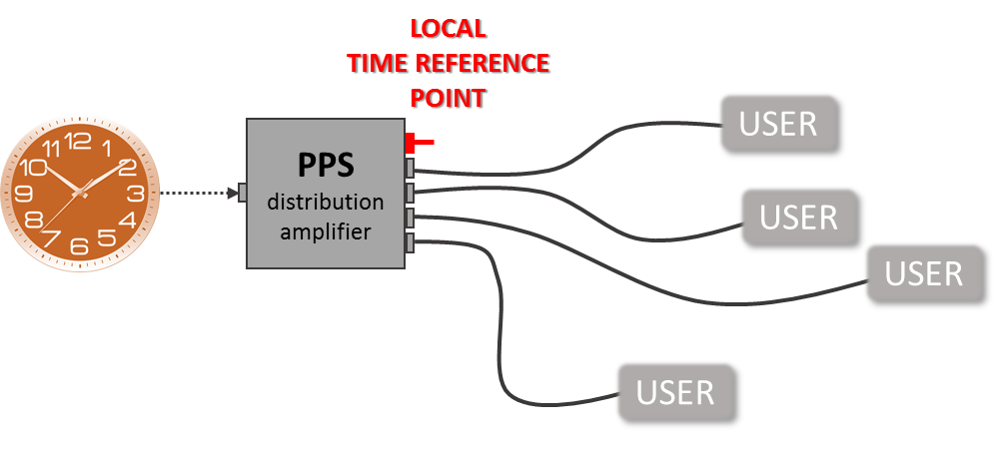
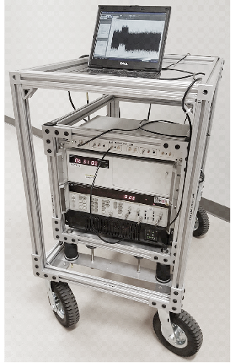
UTC(k) Best Practices
Local Dissemination
Co-located users require TIC and a pivot point
Users in different rooms/buildings require a clock trip between the user and the local time reference point (TIC and a portable clock)
The delay of the PPS signal at each user should be regularly measured to monitor possible changes.
Distribution via coaxial cable requires measurements every year
Distribution via active systems (i.e. active oprical fiber) may require measurements over shorter intervals

Slide 34
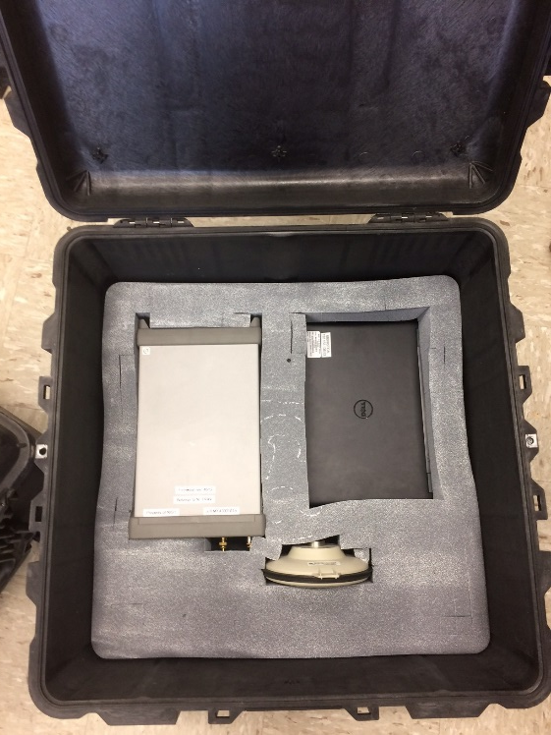
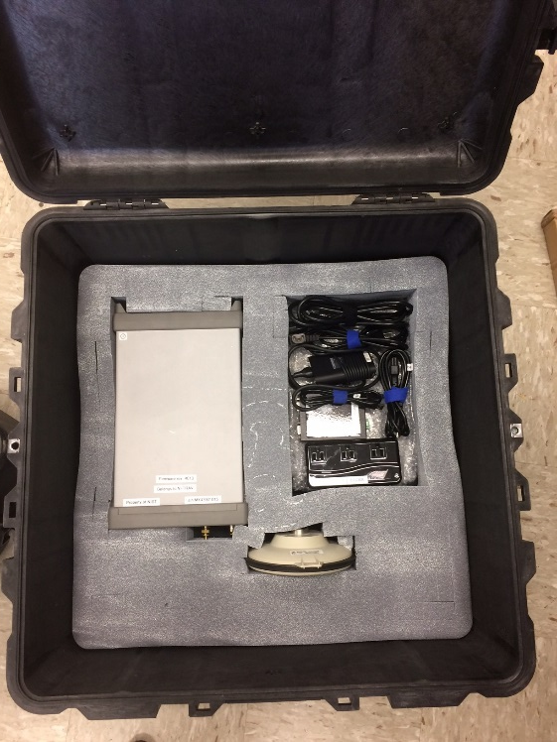

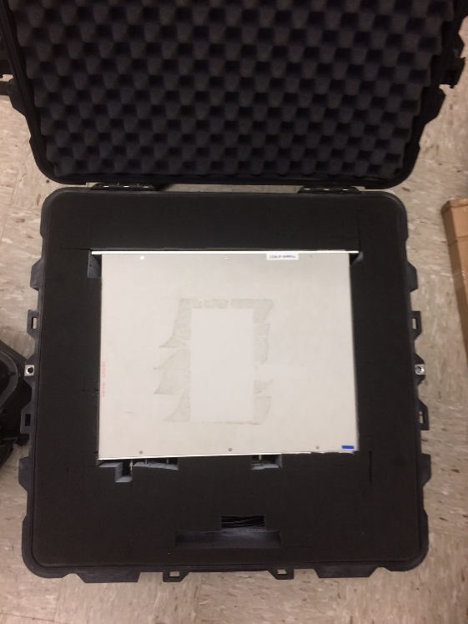
NIST Travelling System

Slide 35
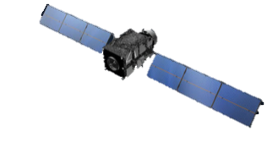
Differential calibrations
Antenna (INTDLYT)
Differential calibration of GPS link
(NIST and CGGTTS definitions)
CABDLYT
Antenna (INTDLY1)
Antenna (INTDLY2)
ΔtT
(INTDLYT)
RCVRT
LOCAL
TIME REFERENCE PLANE
CABDLY1
CABDLY2
UTC1
PDA
REFDLYT
UTC2
PDA
antenna
antenna
LOCAL
TIME REFERENCE PLANE
Δt1
(INTDLY1)
Δt2
(INTDLY2)
REFDLY1
PPSin
REFDLY2
PPSin
rcvr time ref
(PPSout)
rcvr time ref
(PPSout)
RCVR1
RCVR2
RCVRT at ①
REFSYS1 − REFSYST = INTDLY1 − INTDLYT
CV_{1T} − CV_{2T} = INTDLY1 – INTDLY2
REFSYS2 − REFSYST = INTDLY2 − INTDLYT
Differential calibration of GNSS equipment
RCVRT at ②

Slide 36
Absolute calibration
simulator

